Slide 1
Design patterns

Slide 2
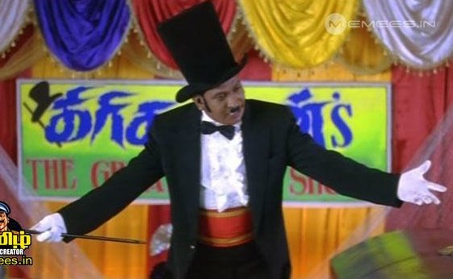

Slide 3
Patterns
Creational Patterns
Factory Pattern
Structural Pattern
Facade Pattern
Behavioral Pattern
Strategy Patttern

Slide 4
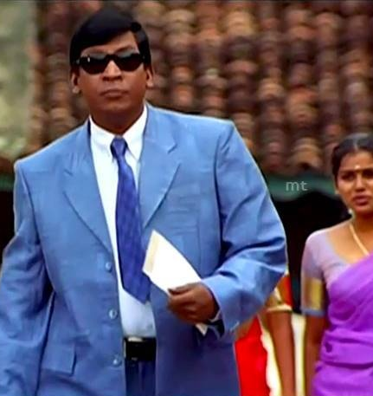
Factory Pattern
User story
Once upon a time there lived a man who was known to be the big shot and ruled the trade
Secret – His x-good travels in all possible ways
Our story
We are the one that are 1 in million
We are the creators of mostly used device
We create all possible device

Slide 5
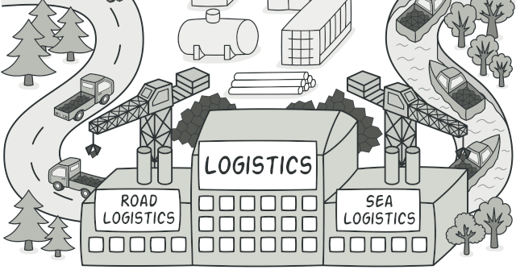

Slide 6
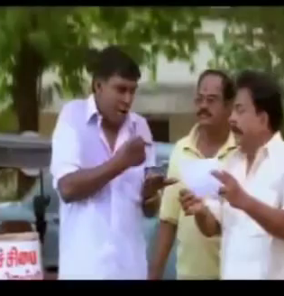
Facade pattern
Story
We go into restaurant and order food comes to table
Yeah we got the façade pattern
Its all about masking the complex architecture

Slide 7
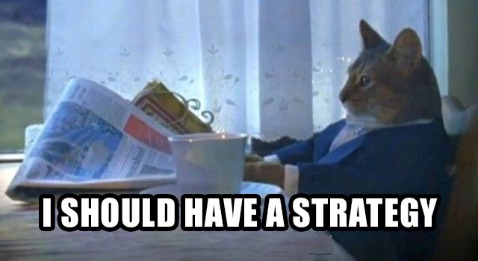
Strategy pattern
We are planning to run a pawn shop
We are good one not to most extreme right
Let us see our strategy

Slide 8
